Slide 1

Applied Statistics
Getting Started in R
Notes:
LOBBY LAYOUT
Typical screen
Mute mics
SWITCH TO OVERVIEW
note the file pod with documents
note the groups
Hands up question – thumbs up excited/thumbs down anxious?
Handsup questions – are you sick of hearing my voice yet? Typically have to wait for class.

Slide 2
What are R and RStudio?
R is a programming language used for statistical computing.
You need to install R FIRST.
RStudio is built on R and provides a more user-friendly interface for using R. This is what we will use in class.
You need to install Rstudio after you install R.
The instructions are found here:
https://lhartigan15.github.io/LLO8200_summer2021/Installing%20R%20and%20RStudio.pdf
Note: It is important to note the differences between R and RStudio. R is a programming language used for statistical computing while RStudio uses the R language to develop statistical programs. In R, you can write a program and run the code independently of any other computer program. RStudio however, must be used alongside R in order to properly function.
R and RStudio are not separate versions of the same program and cannot be substituted for one another. R may be used without RStudio, but RStudio may not be used without R.

Slide 3
PC vs Mac
The commands for R are the same for both a PC and a Mac environment.
There are some differences in the user interface (particularly in the initial set up when trying to knit to pdf). Let me know if you are on a Mac and unable to knit to pdf (after following all instructions in this slide deck).

Slide 4
R Markdown files - .Rmd files
Each week you will receive access to a .Rmd file. This means that the file extension will be .Rmd (other file extensions that you are probably familiar with are .docx and .xlsx and .txt). We will use the .Rmd files to communicate with R.
You will NOT need to create .Rmd files from scratch but rather simply edit the ones you receive from the faculty in order to complete your assignments. IMPORTANT: Set up a separate folder for our course Good file management will save you a lot of time and headaches. You should download the .Rmd file to a folder for our course. DO NOT LET the .Rmd file LIVE in your Download Folder. R does not like to read files from the Download Folder on your computer.

Slide 5

Opening the .Rmd file
Once your .Rmd file is downloaded you can open the file one of two ways:
Double click on the .Rmd file directly from the folder where you saved it . This should cause Rstudio to open and display the file in the upper left panel of the program.
OR
Click on the Rstudio icon
Then Use File> Open File from the menu bar and browse to find the folder where you have saved the .Rmd file. Click on the file name to open it and it should display the file in the upper left panel

Slide 6
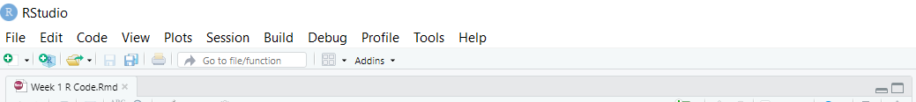
You Should See 4 Panels in your .Rmd file.
If you do not see 4 panels, use the min/max controls to get them all to display
Note: You can customize the colors and fonts of the panels using
Tools> Global Options from the menu bar.

Slide 7
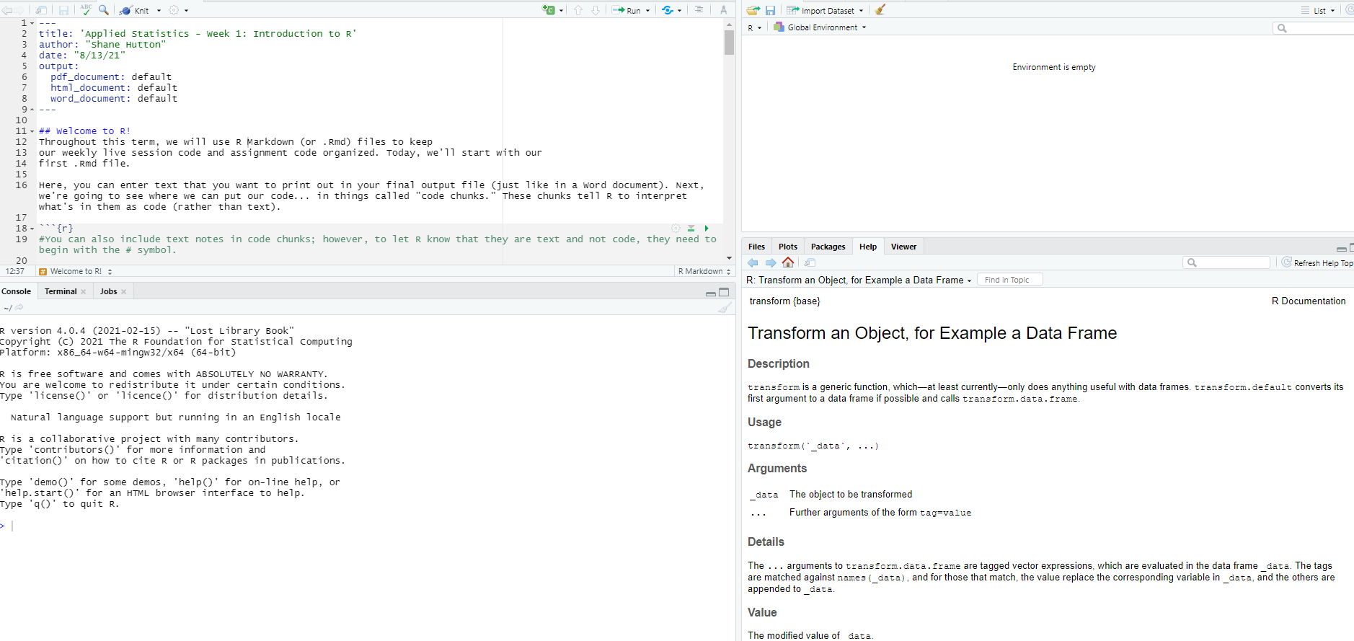
Overview of each of the 4 Panels in your .Rmd file
Upper Left panel is where your source code and text will go. This is where the .Rmd file will be displayed when you open it. This is saved when you save and close the file.
Lower Left Panel: this is called the console. When you run a “chunk of code” it will be displayed here (except some plots). This will be used to test your code. This panel is not saved when you save and close the file.

Slide 8
Overview of each of the 4 Panels in your .Rmd file
Upper Right panel : This shows what is in R’s brain right now. It is called the Global Environment and will be used to confirm that your data has been properly read in.
Lower Right Panel: this area has a variety of tabs. We will use the Packages tab to install Packages. You will see Plots displayed here and you can use the Help feature from here.

Slide 9
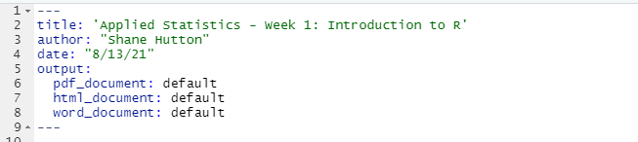
A closer look at the .Rmd file – The YAML header
Look in the upper left-hand panel.
Notice that the .Rmd file has a header starting on line 1.
This is called a YAML header – “Yet another Markdown language.”
Your .Rmd file MUST have a header in exactly this format which will be in the .Rmd file that you download.
It MUST begin on line 1 and it MUST begin and end with the 3 dashes.
You can edit the title and author and date. The output shows the options for “knitting” the file. Knitting does what it sound like – it knits together the text and the output and the code. This is what you will submit for your assignments. More on this later.

Slide 10
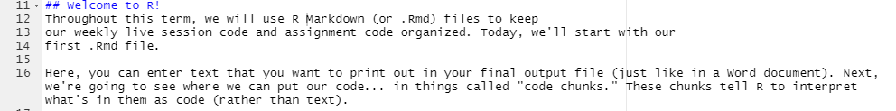
A closer look at the .Rmd file - Text
Look in the upper left-hand panel.
Notice that the .Rmd file has text starting on line 11
One of the great features of R is that you can just type text as though you were using Word. The text will appear as part of your output file when you knit everything (last step).
This allows you to interpret the output right in the file. You will answer the assignment questions in this manner.
NOTE: on line 11 you see ## symbols. This makes the text that follows into a heading in the output file. For now, you can just use what we give you. If you want to adjust the way the output looks you certainly can learn about headings. Typically, text needs no symbols to differentiate it from code UNLESS the text is in a “code chunk.”

Slide 11
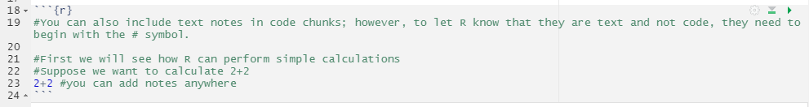
A closer look at the .Rmd file - Code Chunks
Notice that lines 18 to 24 are gray
This is called a code chunk in R.
Notice that it MUST begin and end with the appropriate symbols to tell R that it is a code chunk.
The code chunks that you need will be in the .Rmd file that you receive. You will just need to edit it to complete your assignments.

Slide 12
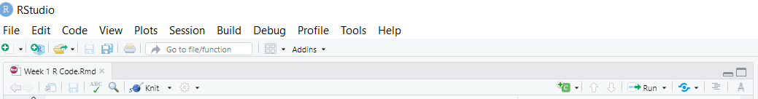


Adding code chunks
You may want to add a new code chunk sometime. You can use the dropdown arrow in the menu bar to insert a code chuck.
OR
You can just type the opening and closing lines to delineate code.
BUT be VERY careful that you type it just exactly as it is shown – curly brackets are necessary!
Mac users can add a code chunk by pressing
+ + i

Slide 13
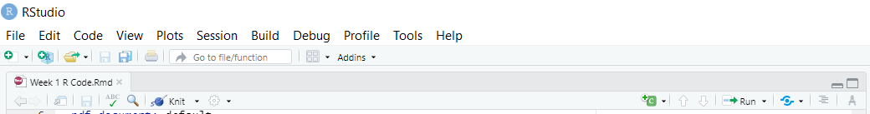
Running a Code Chunk
In order to run a code chunk you can:
Use the “Play” button at the top right-hand corner of the code chunk
OR
2) Highlight the code and use the drop-down arrow next to the Run button from the main menu at the top of the upper left panel:
The output will show up in the console and in the upper left panel just below the code chunk that you executed.
Mac Users can run a code chunk by pressing
Shift + + Enter

Slide 14
Adding text within a Code Chunk
You can easily add text within a code chunk by preceding the text with a # symbol.
This allows you to put some notes/documentation into the code chunk for future reference.
This also allows you to tell R to ignore the code chunk for the moment. Often you might think you don’t need a code chunk and so you delete it. Later, you discover you need it. So, instead of deleting it, you can make R ignore it for the time being by putting a # symbol in front of each line in the code chunk.

Slide 15
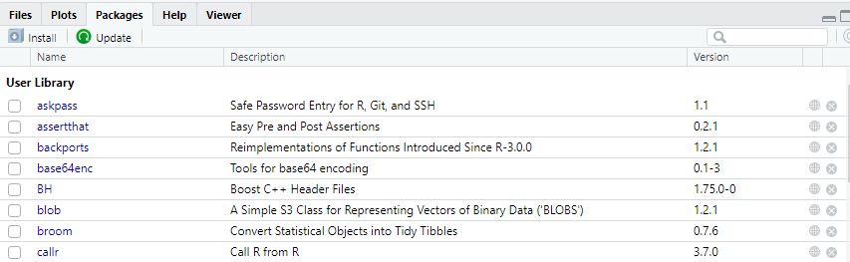
Installing Packages
Tons of free upgrades to the basic R functionality are available. These are called packages.
In order to use a package, you must first install it. You only have to install a package once. Then it will show up on your list of packages in the lower right-hand panel when you click on the Packages tab. Installing a package makes it available for use but you still must load it each time you want to use it.
In the console (lower left panel) type the following:
install.packages(“tidyverse”)
This will install tidyverse. Notice the stop sign in the lower left-hand panel when R is doing the installation. When you see the stop sign, it means R is working on it. Wait until R is finished to do anything else.

Slide 16
Using Packages
After you have installed a package, you must load it in order to use it. You must load the package each time you want to use it, so it is best to do that in the upper left-hand panel in an R code chunk.
Use the library function in a code chunk in order to load a package. Type this in a code chunk.
library(ggplot2)
When you run that code chunk, the package called ggplot will be moved from the “bookshelf” of packages and be available to be used. It will then appear in the Package list with a check mark.

Slide 17
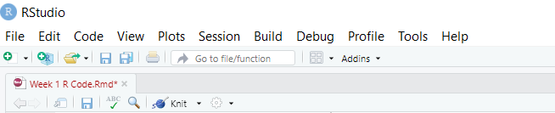
Knitting to HTML
Once you have all your code chunks working and you have added all the text that you wish to see in your report (answered all the questions in the homework assignment) then you are ready to Knit the file.
To do this, choose drop down arrow next to the “ball of yarn” on the main menu in the upper left-hand panel. It says “Knit”. Try knitting to HTML first.
The knitted file should open for you on your screen and get saved to the same folder where you saved the .Rmd file that you are running. This is the file you will submit to me through the Assignments tab in the LMS!
NOTE: If you do not see the knit button then you have probably opened a .R file and not an .Rmd file. You can only knit .Rmd files.

Slide 18
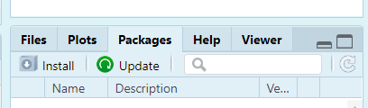
Knitting to pdf – Troubleshooting on a PC
Once you have successfully knit to html, go ahead and try to knit to pdf. If you encounter no errors, fantastic! If you do encounter an error, try the following steps.
Update all out-of-date packages.
    In the lower-right pane, you’ll see a “Packages” tab. Click the green “Update” button on that tab. This will pull up a list of everything that is out of date.
Install tinytex by typing the following code into your console (and hitting enter):
  tinytex::install_tinytex()
After that is finished installing, go to FILE > QUIT SESSION
Re-open the .Rmd file/RStudio and attempt to knit to pdf again.

Slide 19
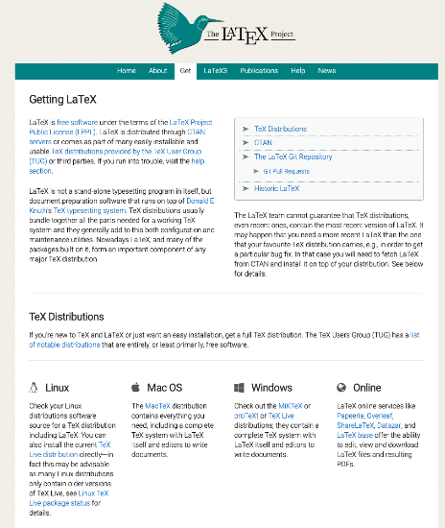
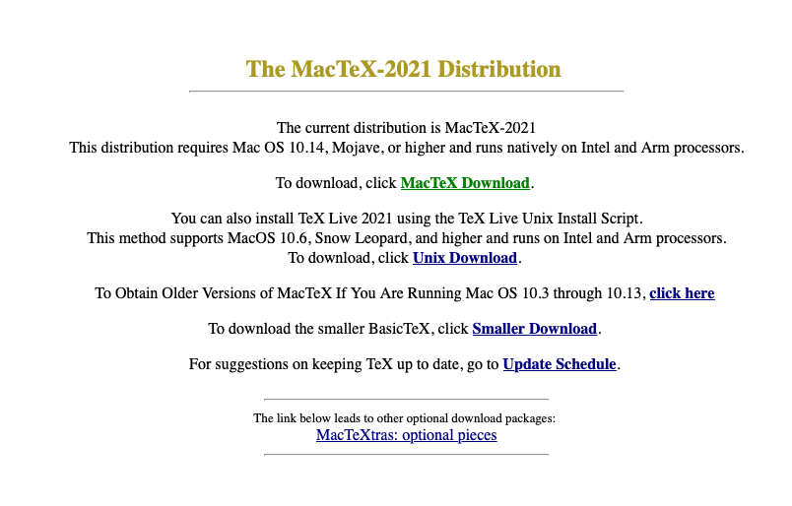
Knitting to pdf – Troubleshooting on a Mac
Mac Users will need to download MacTeX. Go to https://www.latex-project.org/get/
Then here
This is a big file and will take some time to download and install.
Click here

Slide 20
Knitting to pdf – Troubleshooting on a Mac
Sometimes Mac users experience problems when knitting files that do not occur when running the code chunks individually. This is often a result of ‘knitr’ restoring the working directory to the original directory.
You can fix this by setting the root directory in knitr in your first code chunk by including the following code:
opts_knit$set(root.dir = " ")

Slide 21
CONGRATS
If you have successfully knitted to a pdf and/or HTML file, then you are well on your way!
See you in class!
Each week we will go over the R code needed to implement the weeks stat tools in R.

